Slide 1

Prevalence of Hearing Loss in the United States by Industry
Yiqi Zhang 2019.12.09

Slide 2
Overview
Estimate the prevalence of hearing loss among U.S. industries.
2000–2008 audiograms for male and female workers
Ages 18–65
18% of workers had hearing loss.
Better engineering controls for noise.
Stronger hearing conservation strategies.

Slide 3
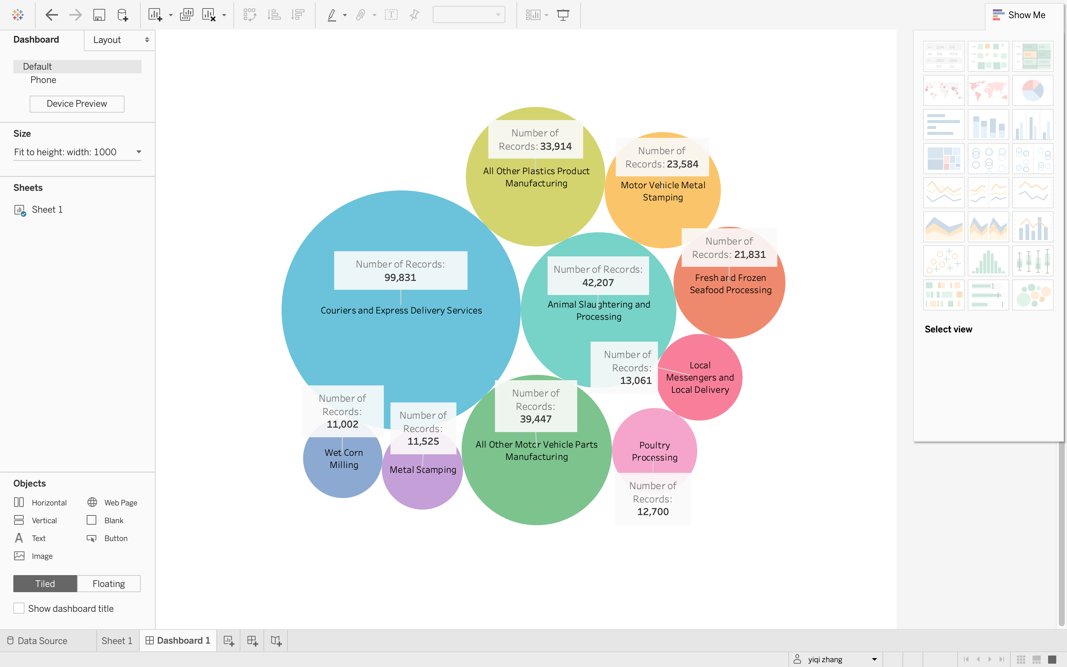
Industry Categories

Slide 4
Prevalence of Hearing Loss in the United States by Industry
Couriers and Express Delivery Services & All Other Motor Vehicle Parts Manufacturing
Mining, Manufacturing, and Construction Industries (High-risk)
Traditional ‘‘low-risk’’ industries like Real Estate

Slide 5
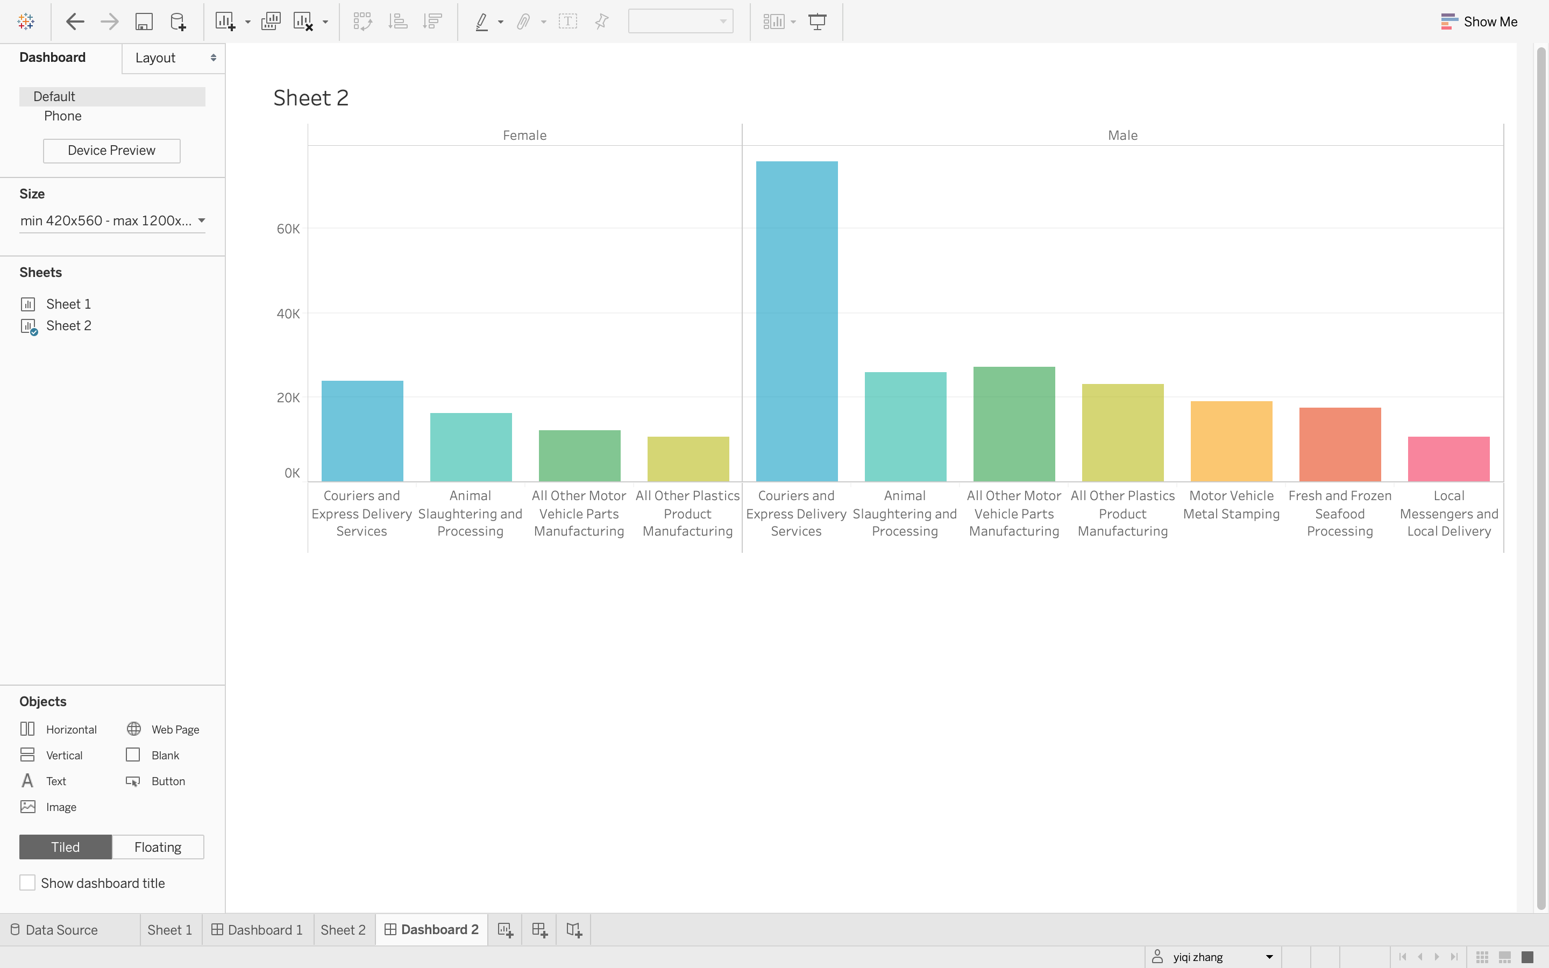
Female & Male Prevalence of Hearing Loss

Slide 6
Female & Male Cases Analysis
Male workers are easier to get hearing loss
Industries about transportation prefer employing male workers
The difference of physical fitness between males and females

Slide 7
Conclusion
Workers in the Mining, Manufacturing, and Construction industries need better engineering controls for noise and stronger hearing conservation strategies.
Industries need pay more attention to male workers’ physical fitness.
More hearing loss research is also needed within traditional ‘‘low-risk’’ industries like Real Estate.

Slide 8
Recommendation
Insurance contract
Security Guaranty Mechanism
Working Pressure & Psychological Health

Slide 9
Thanks for watching

